Slide 1
Portfolio Risk CAPM
Capital Asset Pricing Model

Slide 2
Portfolio Overview
A basket of assets
May hold stocks, bonds, cash, commodities, derivatives, etfs
Investors aim for a return by mixing these securities in a manner that reflects
Their appetite for risk
Their financial goals
Their time horizon
…
A key concept in portfolio management is diversification
Don’t carry all your eggs in one basket

Slide 3
Portfolio Overview
Developed Markets
Emerging Markets
Derivatives
Cash

Slide 4
Portfolio Overview
Assume investors are rational
Irrespective of their motivation, they want the maximum amount of return for the least amount of risk
Return
Irrespective of their appetite for Risk
A rational investor would choose this return
i.e. the maximum return for a given amount of risk
Risk

Slide 5
Portfolio Overview
Assume investors are rational
Irrespective of their motivation, they want the maximum amount of return for the least amount of risk
Return
Irrespective of their appetite for Risk
A rational investor would choose this return
i.e. the maximum return for the minimum amount of risk
Risk

Slide 6
Portfolio Overview
Assume investors are rational
Irrespective of their motivation, they want the maximum amount of return for the least amount of risk
Return
What about these returns
Risk

Slide 7
Problem
Given you have $100,000 to invest for 1 year.
Treasury bills yield 5% (TBills pay a lot less, but this is for demonstration purposes only)
One alternative is to invest in TBills for no risk where the expected return is 5%.
Another alternative is to invest in stock.
Suppose the possible outcomes from investing in stock are
Probability | Return (%)
.05 | 50
.25 | 30
.4 | 10
.25 | -10
.05 | -30
expected return is calculated by
(0.05 ∗ 0.5) + (0.25 ∗ 0.3) + (0.4 ∗ 0.1) + (0.25 ∗ -0.1) + (0.05 ∗ -0.3)
= 0.1
May get $50K return
May also lose $30K

Slide 8
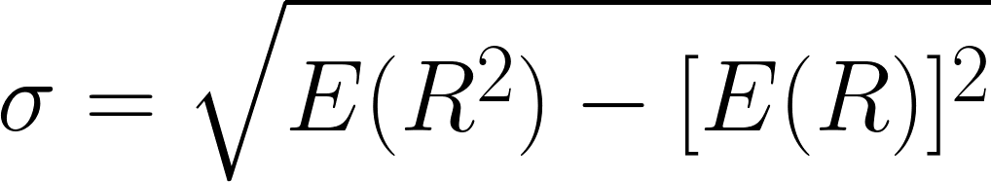
Quantifying Risk
Often std deviation is used
Expected Return - E(R)
= (0.05 X 0.5) + (0.25 X 0.3) + (0.4 X 0.1) + (0.25 X -0.1) + (0.05 X -0.3)
= 0.1
[E(R)]² = 0.01
E(R²)
= (0.05 X 0.5²) + (0.25 X 0.3²) + (0.4 X 0.1²) + (0.25 X -0.1²) + (0.05 X -0.3²)
= 0.046
std deviation = 0.1897

Slide 9
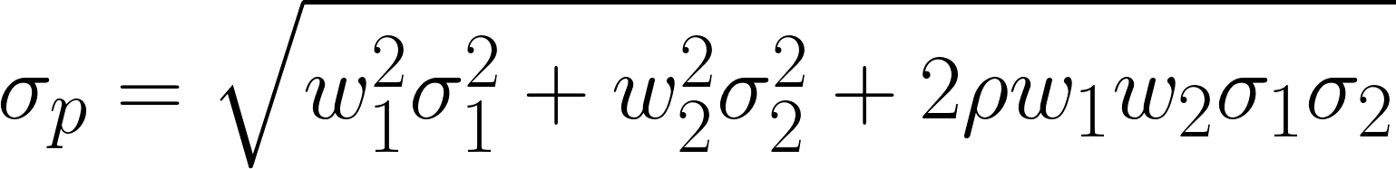
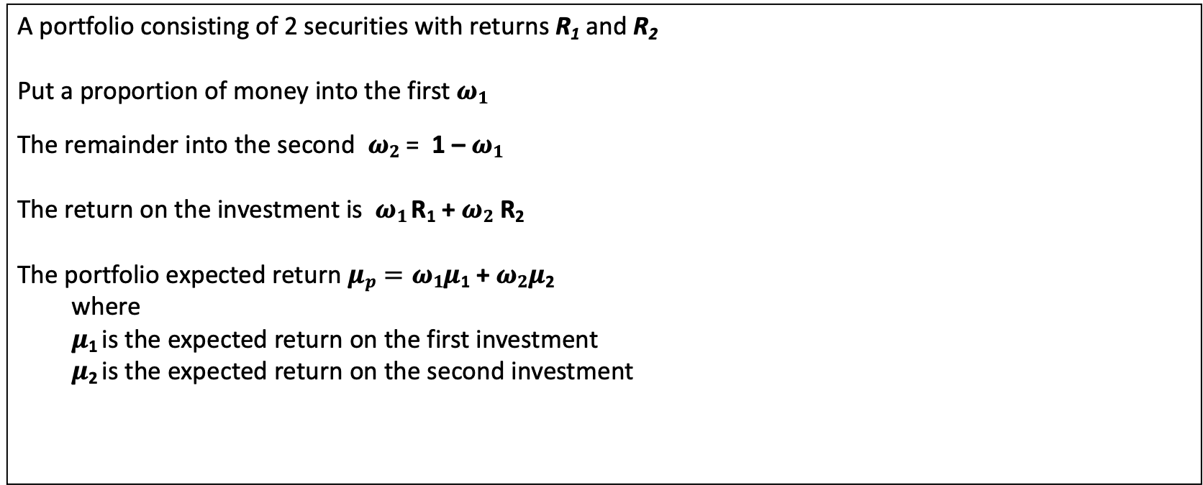
Portfolio with 2 securities
A portfolio consisting of 2 securities with returns R₁ and R₂
Put a proportion of money into the first $ω1$
The remainder into the second $ω2$ = 1 – $ω1$
The return on the investment is $ω1$R₁ + $ω2$ R₂
The portfolio expected return $μp=ω1μ$₁ +$ω2μ$₂
where $μ$₁ is the expected return on the first investment $μ$₂ is the expected return on the second investment
The std deviation of such a portfolio is

Slide 10
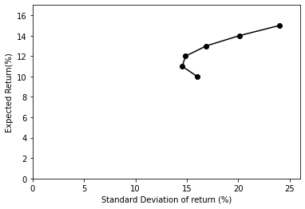
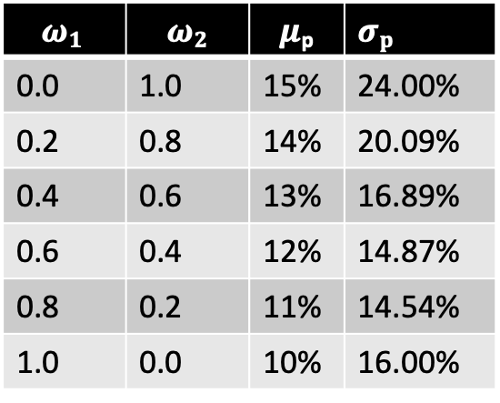

Portfolio with 2 securities
Given the following
$μ$₁ = 10% $σ$₁ = 16%
$μ$₂ = 15% $σ$₂ = 24%
$ρ$ = 20%
The expected return and standard deviation for this portfolio for weights of
(0%, 100%),
(20%, 80%),
(40%, 60%),
(60%, 40%),
(80%, 20%),
(100%, 0%)
Most investors are risk averse They want increased expected returns while reducing std deviation of return. They will want to move as far as possible in a North East direction. Analysis such as this helps investors make more informed investing decisions.
$$ω1$$ | $$ω2$$ | $μ$_{p} | $σp$
0.0 | 1.0 | 15% | 24.00%
0.2 | 0.8 | 14% | 20.09%
0.4 | 0.6 | 13% | 16.89%
0.6 | 0.4 | 12% | 14.87%
0.8 | 0.2 | 11% | 14.54%
1.0 | 0.0 | 10% | 16.00%

Slide 11
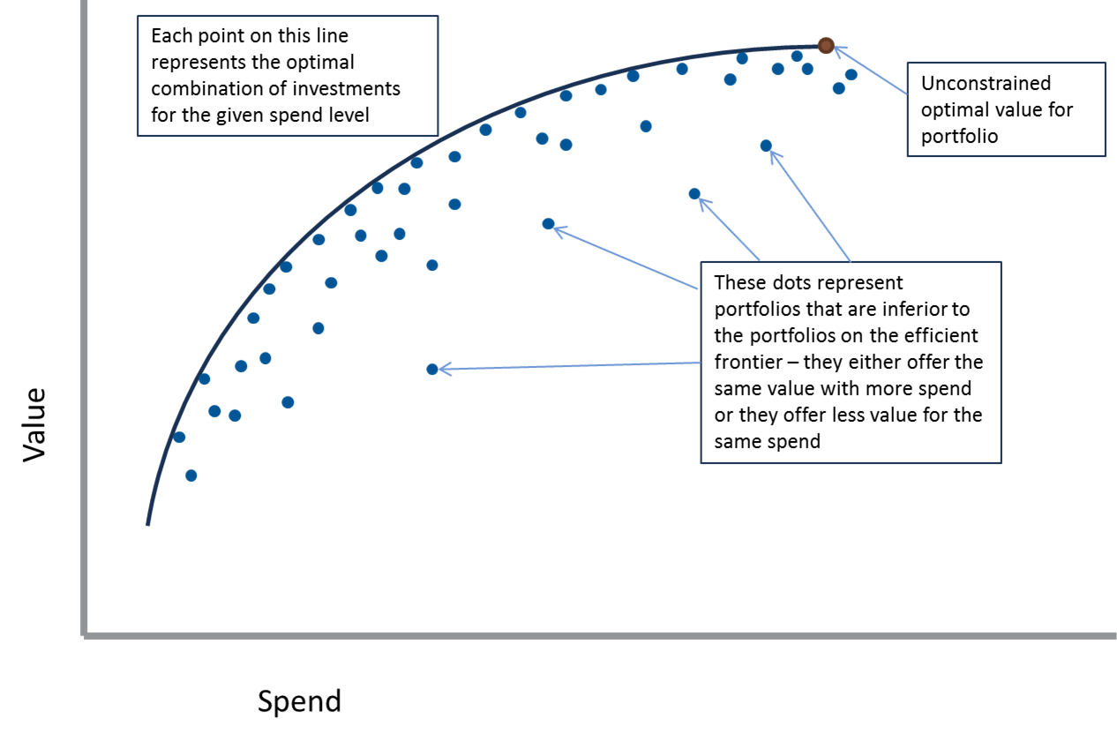
Efficient Frontier
An investor can
add a third investment to the portfolio
combine it with any combination of the first 2 produce a new risk return.
They can repeat this with a 4th, 5th investment etc.
Eventually we reach the limit of how far North West we can go.
This is known as the efficient frontier

Slide 12


